Slide 1
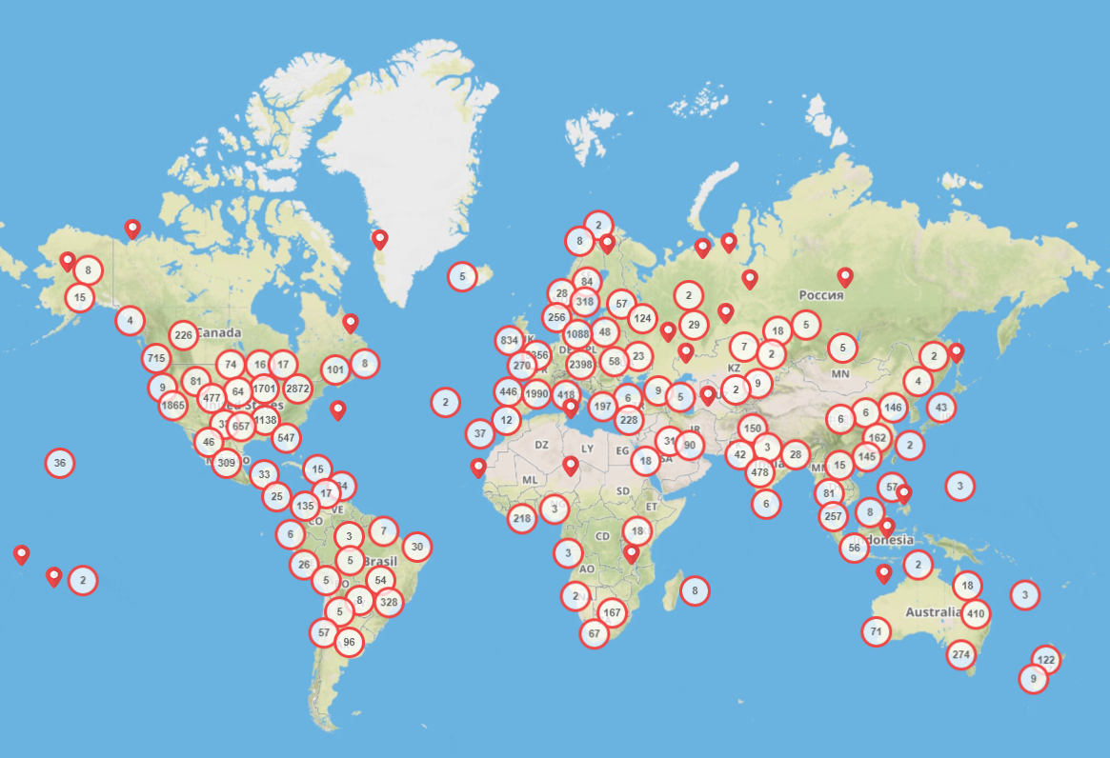
3d Hubs’ Network of Suppliers
Globally 28,524 suppliers
USA ~ 9,137 suppliers
Europe ~ 13,565 suppliers
Other Regions ~ 5,822

Slide 2
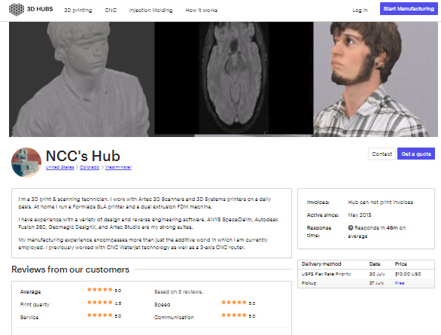
Supplier Profiles
NCC’s Hub

Slide 3
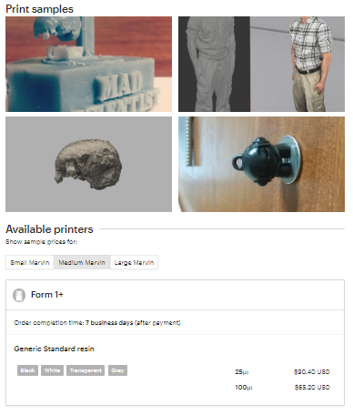
Supplier Profiles
NCC’s Hub

Slide 4
Data Collection
Supplier Profiles
Supplier Attribute | Description
Supplier ID | Unique Identification Number for a Supplier
Average Rating | Ratings from customer reviews (1 to 5)
Print Quality Rating
Speed Rating
Service Rating
Communication Rating
Number of Reviews | Number of Customer Reviews
Activation Date | The day since supplier has been active on 3D Hubs
Average Response Time | Average time to respond to a customer's request
Order Completion Time | Time taken to complete an order
Number of Machines | Number of machines operated by the supplier
Registered Business | Individual operation or a registered business
Location | Country
Number of Images | Number of print sample images uploaded on the profile
Manufacturing Partner | A best performing business status provided by 3D Hubs
Machine Model | Brand and Model of 3D Printer
Resolution | Product Resolution
Material | Material used for printing
Price | Price for a 10 cm tall Marvin Model

Slide 5
What answers do we want from this data?
How many suppliers are located in the US?
Find dormant suppliers (with 0 reviews). When were these suppliers established?
How many suppliers are selling ABS/ PLA material in the US and what is the average price?
Where are the manufacturing partners located?
For ABS/PLA materials, Do the manufacturing partners have higher price than the average?
Do you see any suppliers which are selling at exorbitant prices? Identify Outliers from the data
How does reviews and ratings affect a supplier’s price?

Slide 6
Learning Objectives
How to read a csv file?
How to merge DFs?
How to search for data in DFs?
How to create a box plot?
How to create heatmaps?
How to create histograms?

